Slide 1
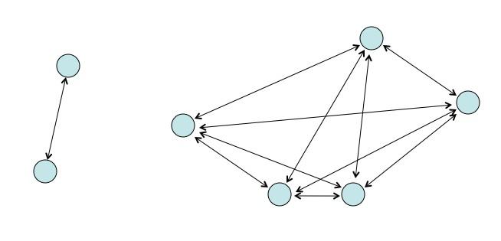
The N-Body Problem
A 3D Numerical Exploration by Nicholas Cemenenkoff

Slide 2
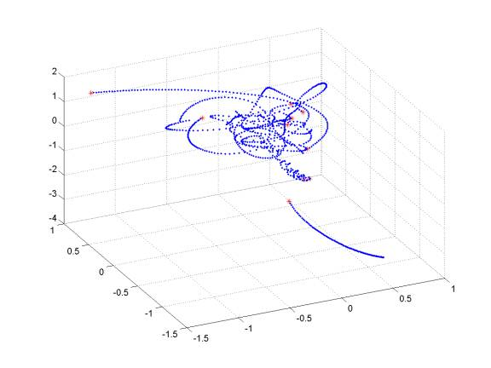
Problem Statement
Given an empty 3D space and a set of masses with distinct positions and well-defined initial velocities,
if accounting only for the gravitational force between the bodies (and not allowing for collisions)…
…what sort of orbital trajectories result? Are they stable? Which factors play a critical role in stability? Is there chaos in the system?

Slide 3
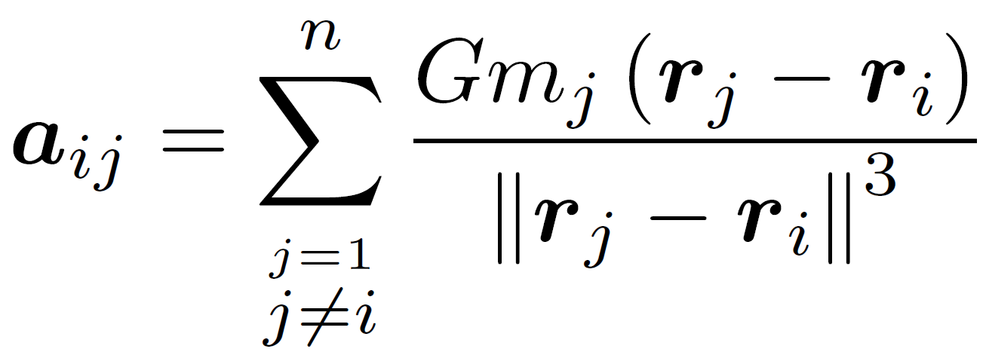
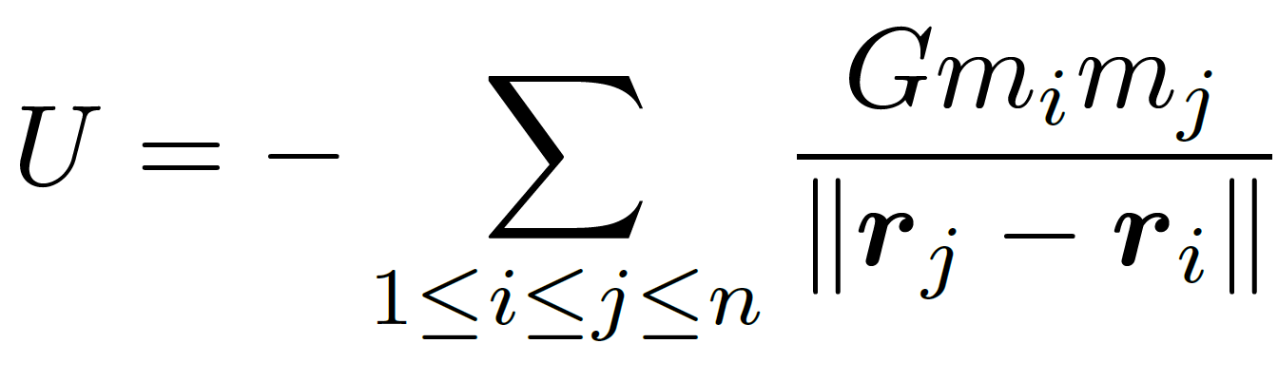
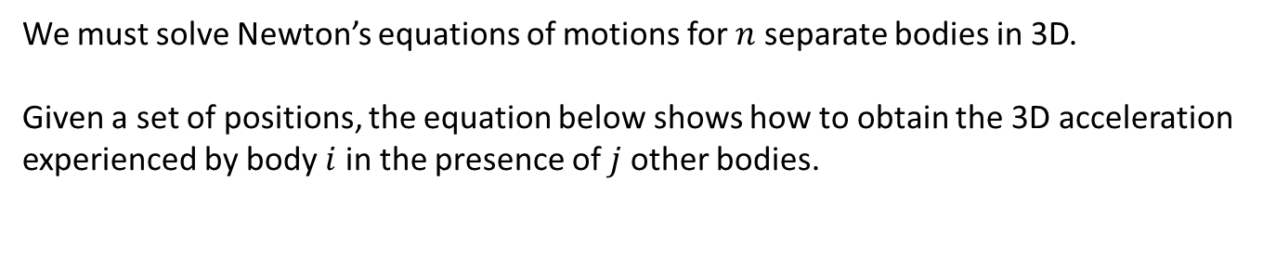
Mathematical Formalism
We must solve Newton’s equations of motions for $n$ separate bodies in 3D.
Given a set of positions, the equation below shows how to obtain the 3D acceleration experienced by body $i$ in the presence of $j$ other bodies.
The accelerations are integrated to find velocities, and then the velocities are integrated to find positions.
The positions give the potential energy, while the velocities give the kinetic energy.

Slide 4
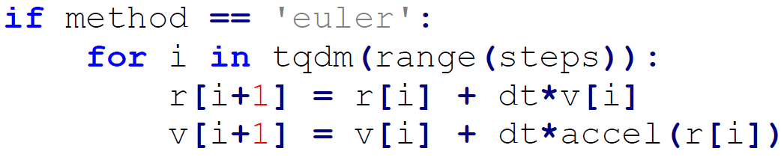
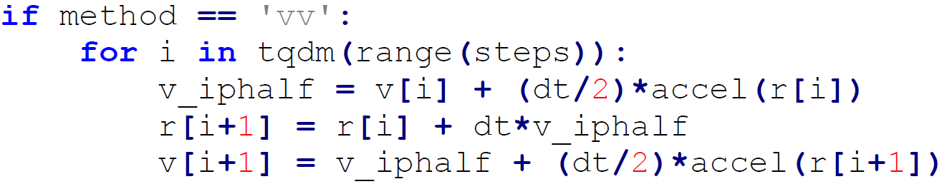
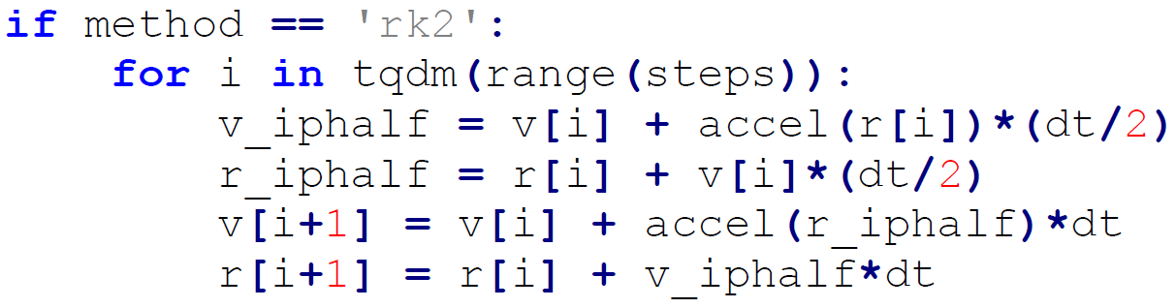
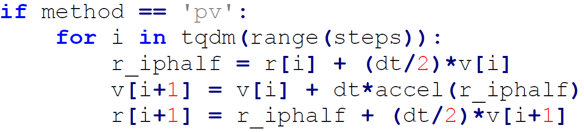
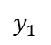

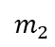
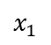
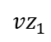
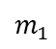
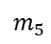
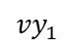
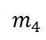
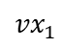
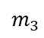
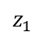
Numerical Implementation
We employ 8 different stepping methods:
Euler
Euler-Cromer (EC)
2nd Order Runge-Kutta (RK2)
4th Order Runge-Kutta (RK4)
Velocity Verlet (VV)
Position Verlet (PV)
Velocity Extended Forest-Ruth-Like (VEFRL)
Position Extended Forest-Ruth-Like (PEFRL)
$$m_{1}$$
$$x_{1}$$
$$y_{1}$$
$$z_{1}$$
$${vx}_{1}$$
$${vy}_{1}$$
$${vz}_{1}$$
$$m_{2}$$
$$m_{3}$$
$$…$$
$$m_{4}$$
$$m_{5}$$
The code is cleaner with 3D arrays.

Slide 5
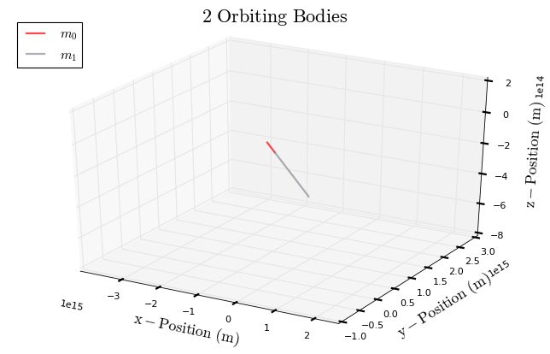
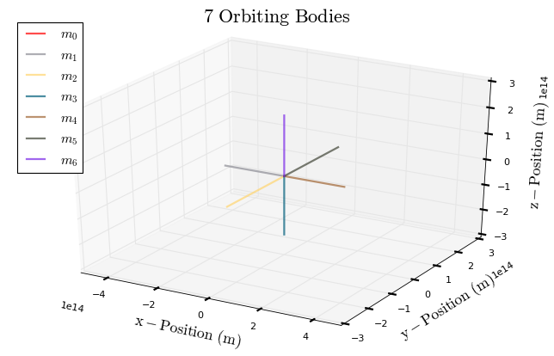
Checking the Model with Symmetry
These system behaves exactly as your intuition might expect, so we can have confidence in the model.

Slide 6
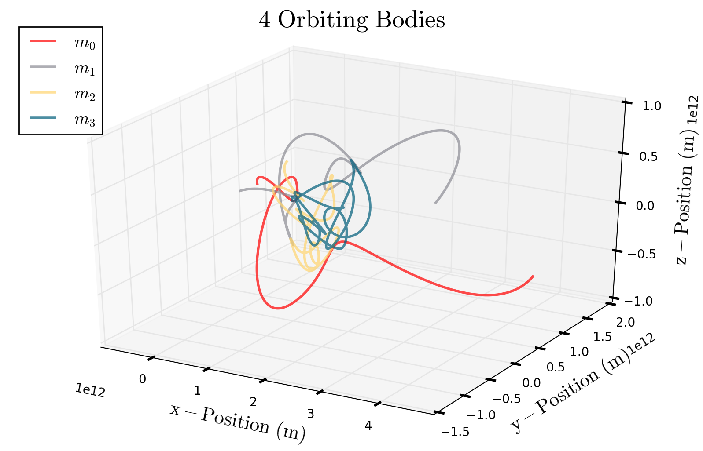
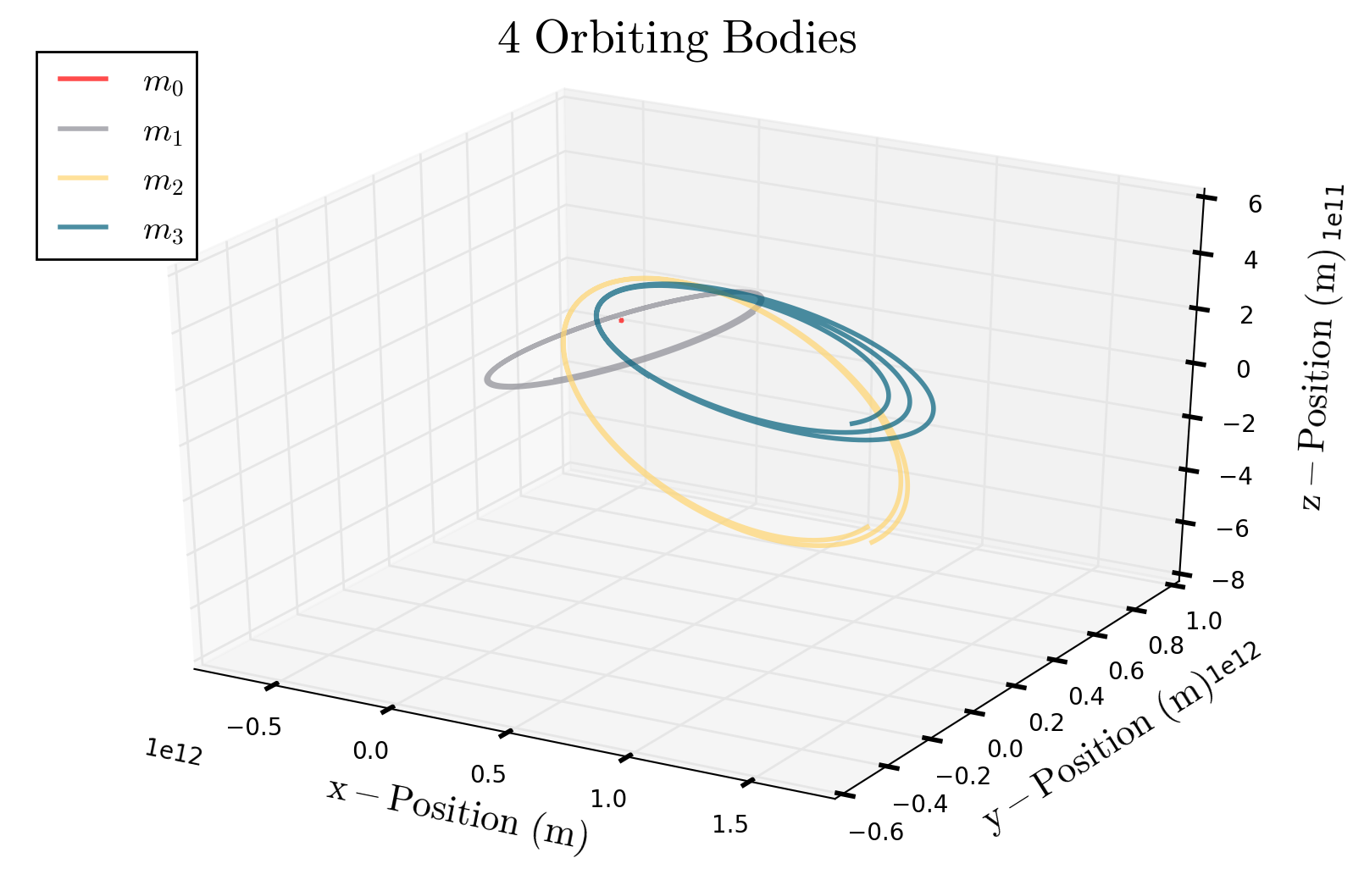
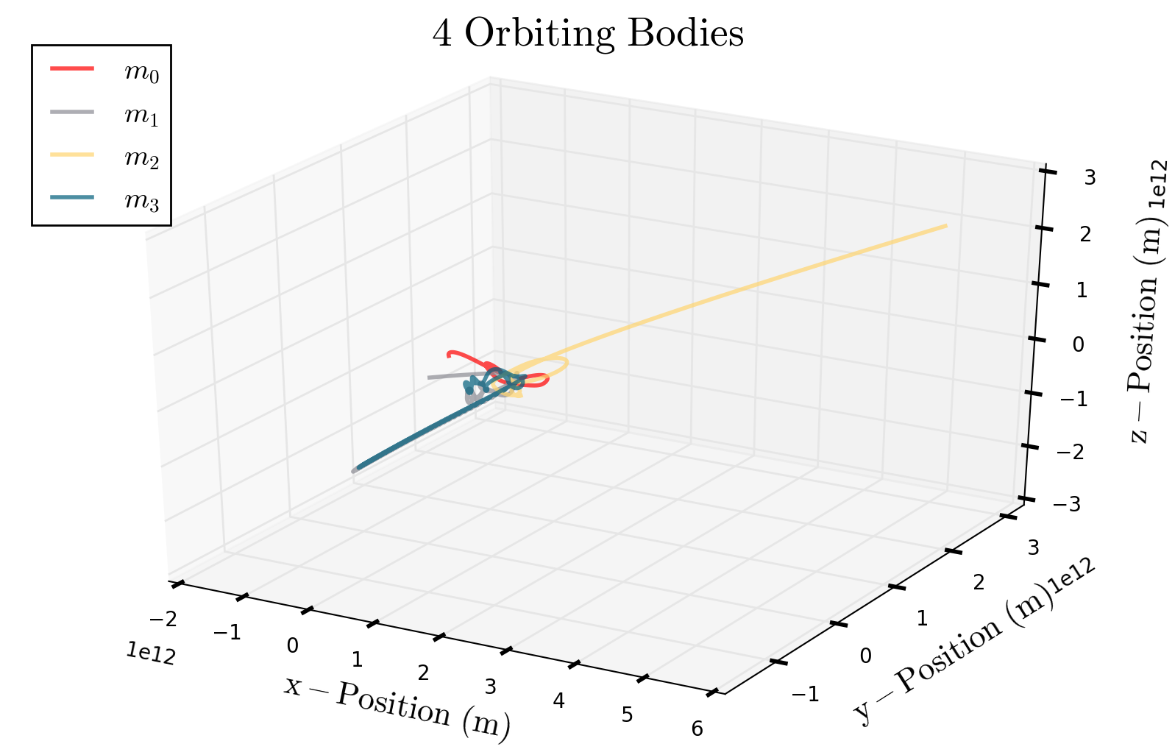
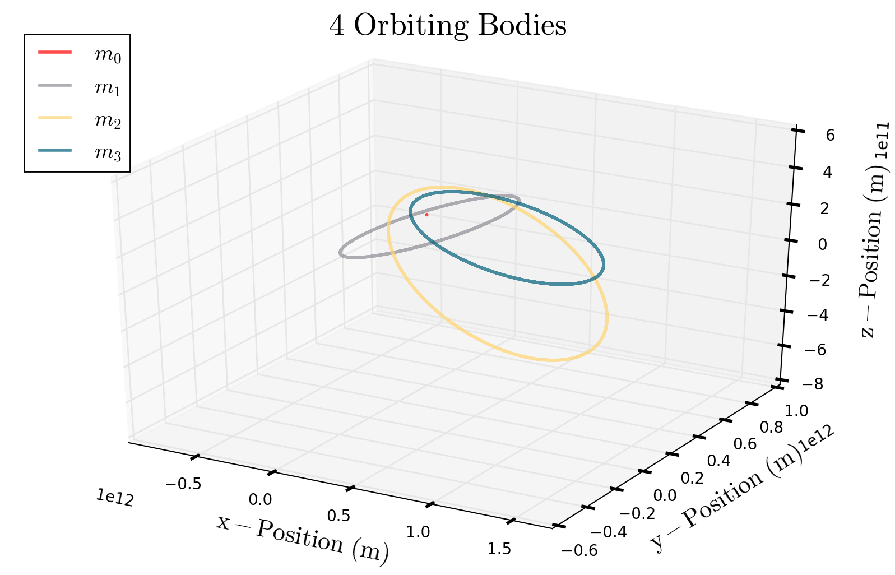
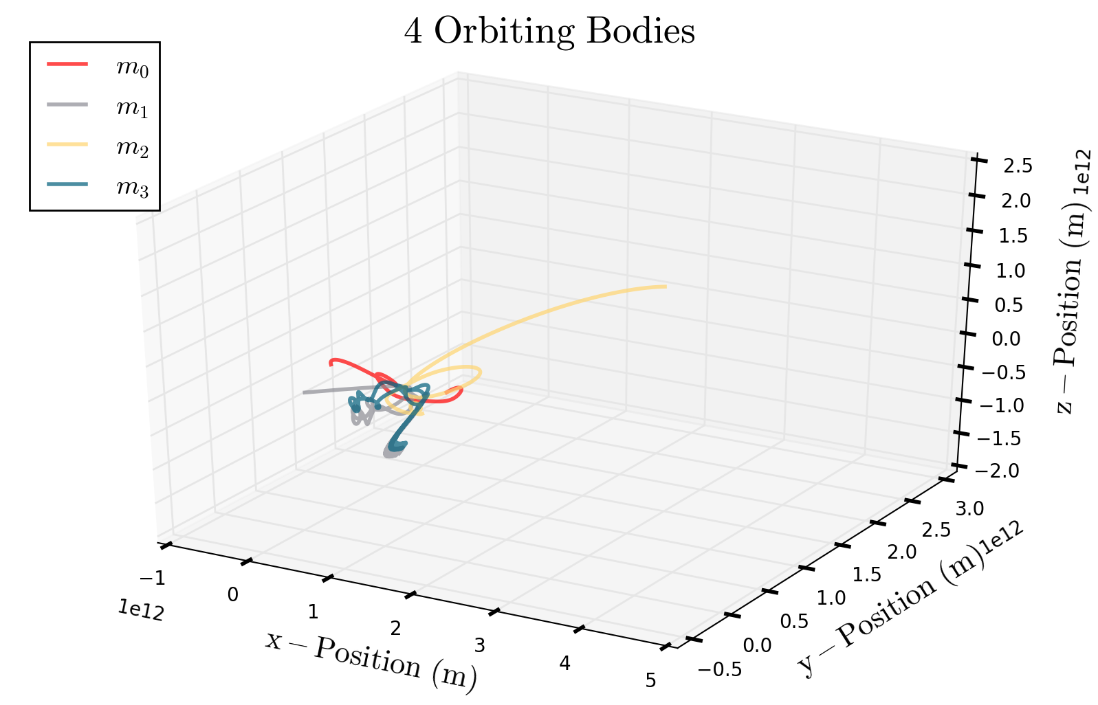

Numerical Results for N=4
IC2
IC1
Euler
We have two sets of initial conditions:
IC1 produces stable ellipses while IC2 is more chaotic.
PV
PEFRL

Slide 7
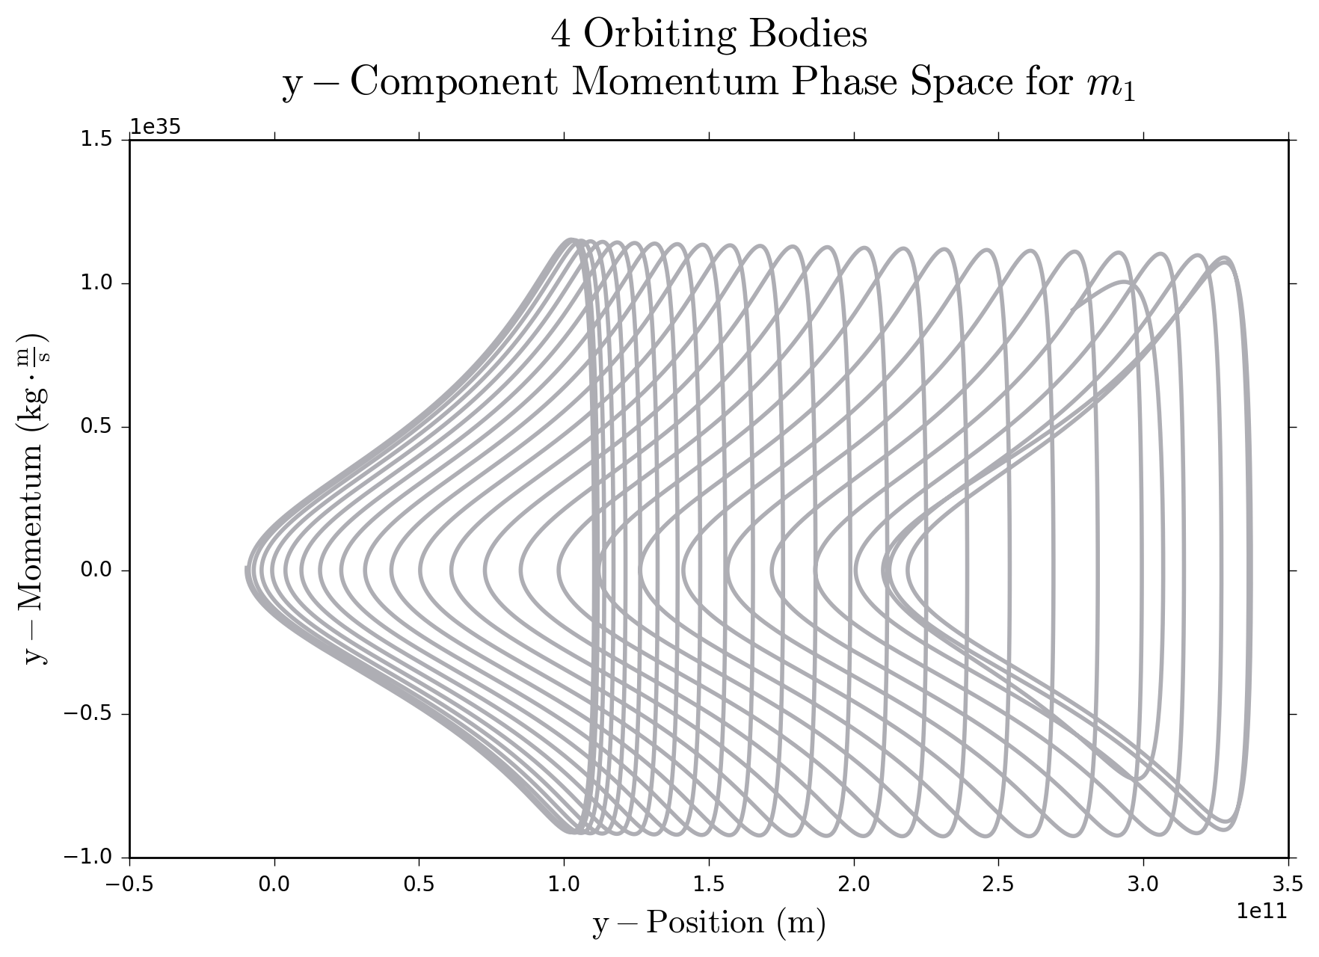
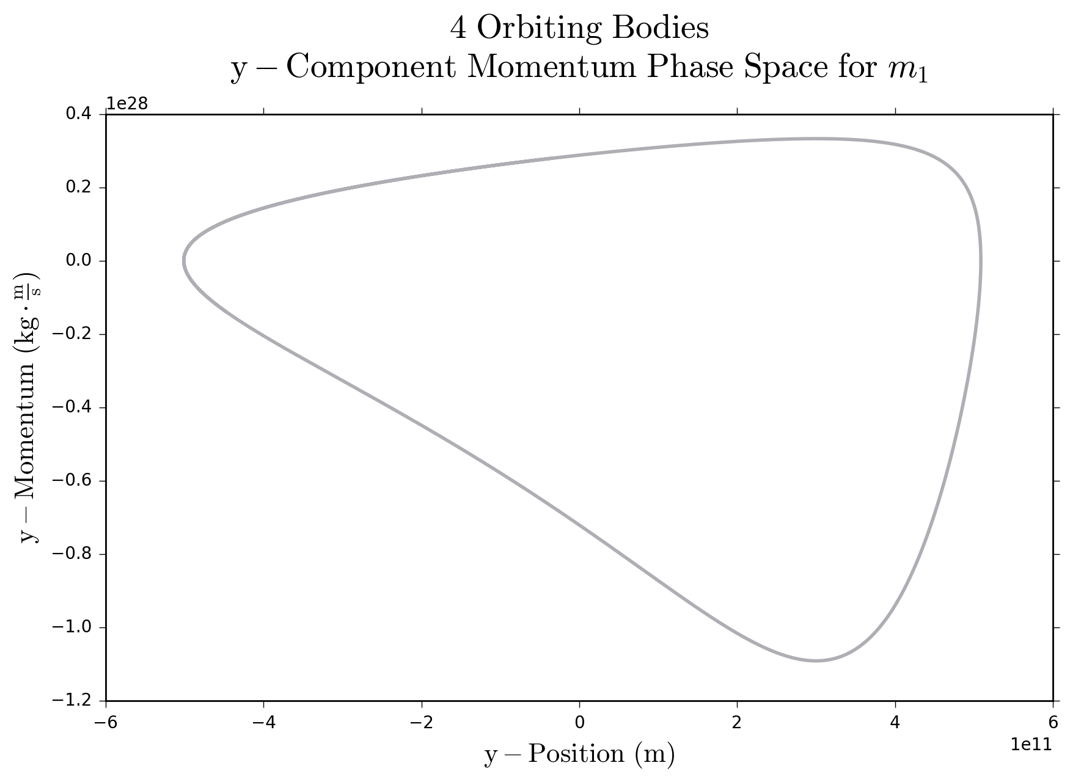
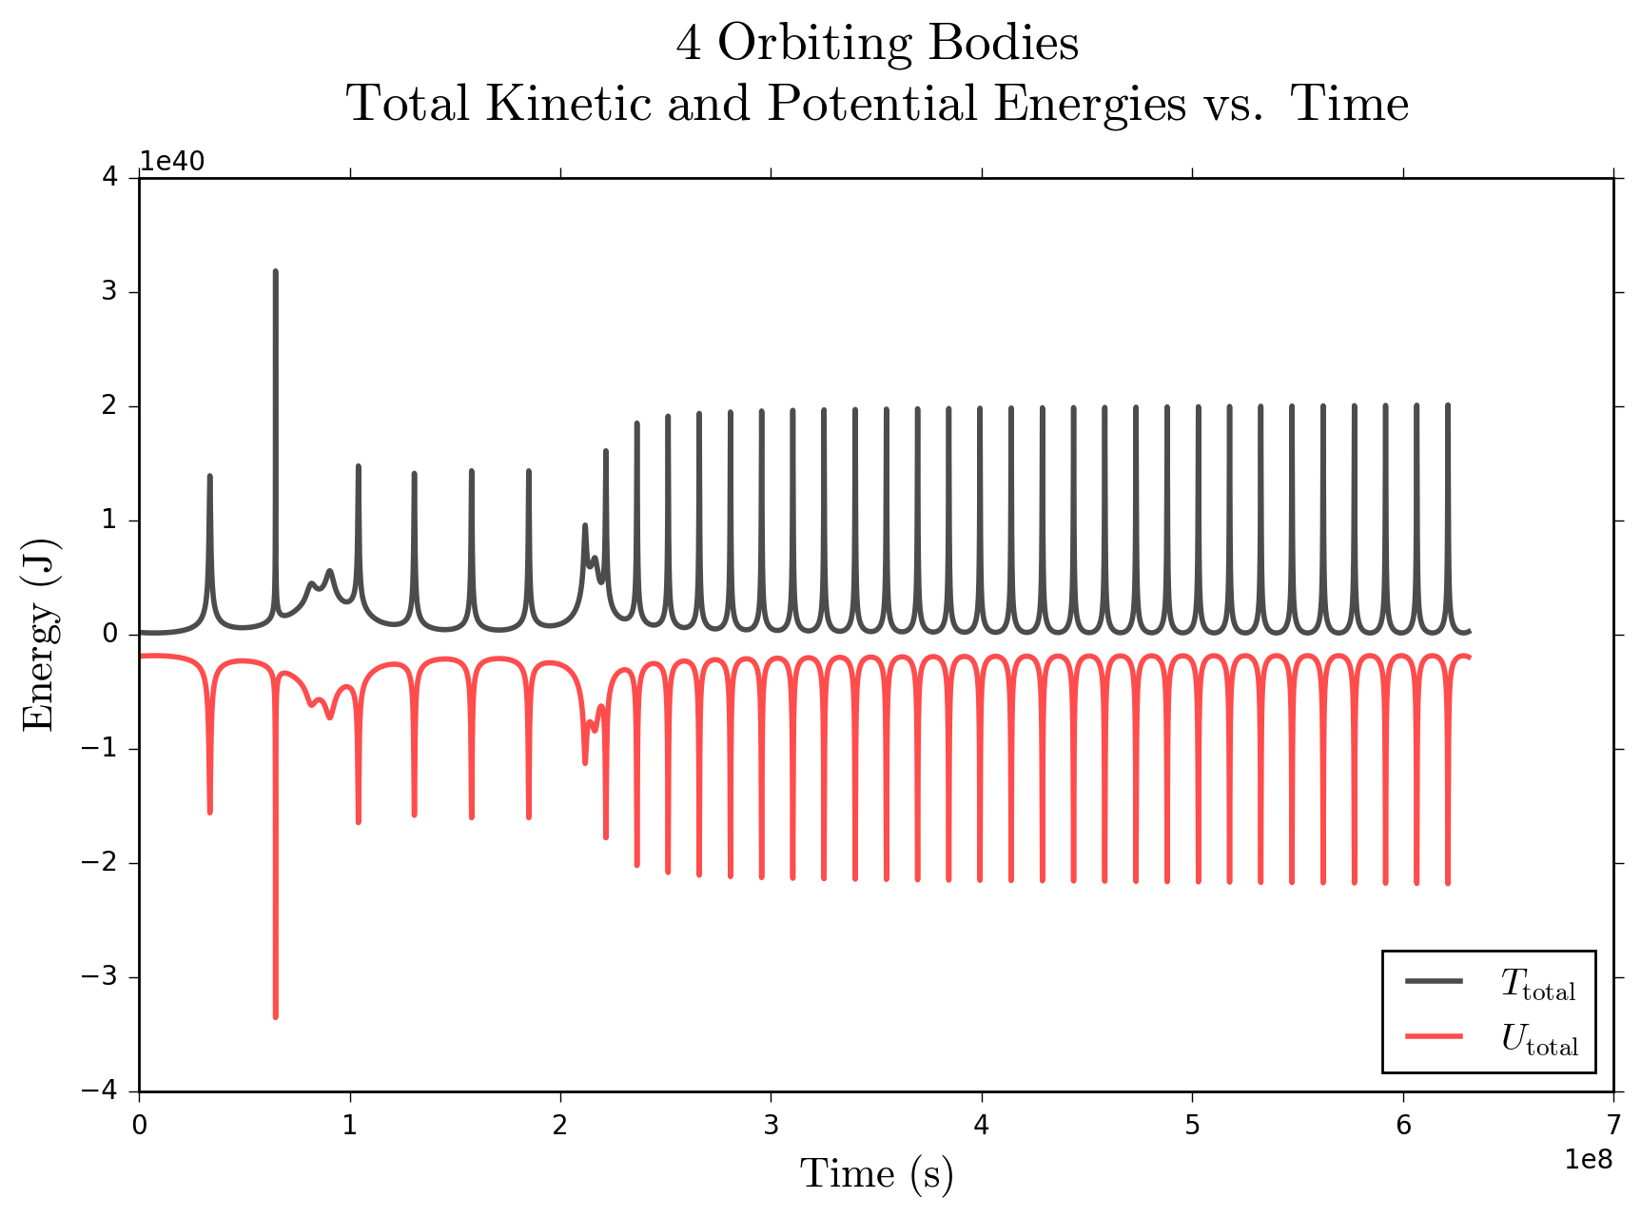
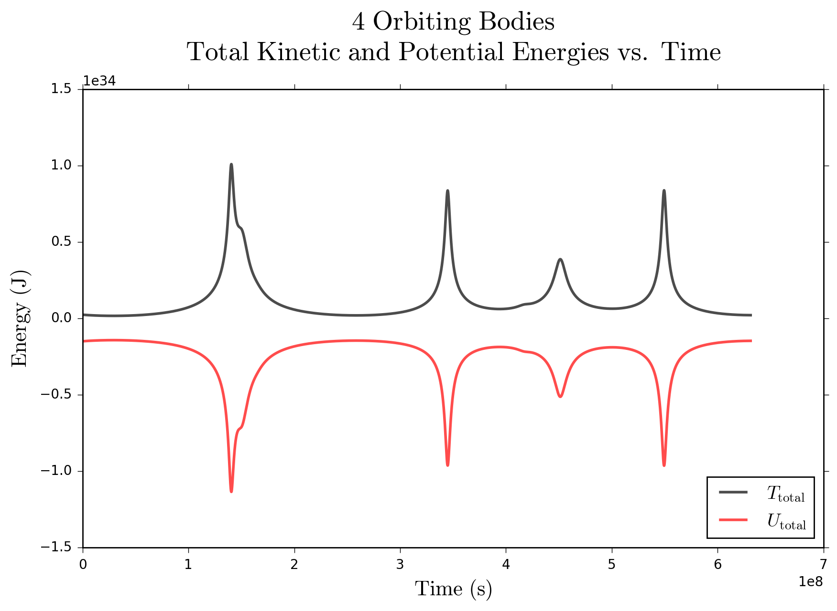
Investigating Energy
A few questions to ponder:
Which one is IC2?
Which one is IC1?
How can we tell?
Is energy conserved?
What do the peaks mean?

Slide 8
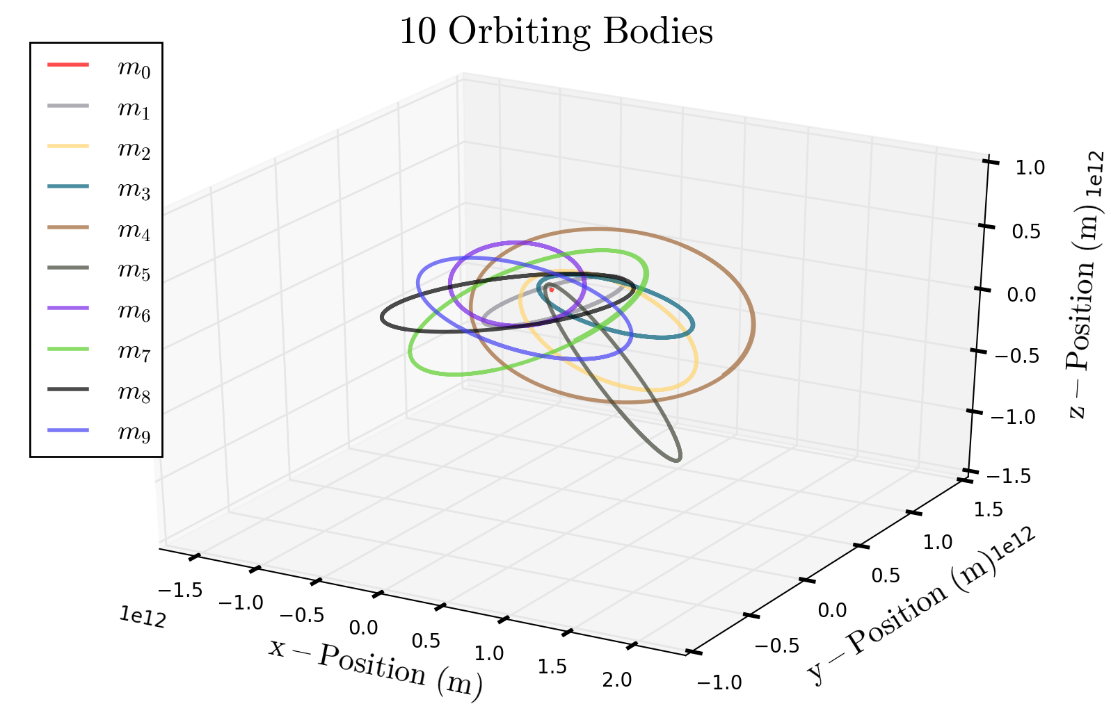
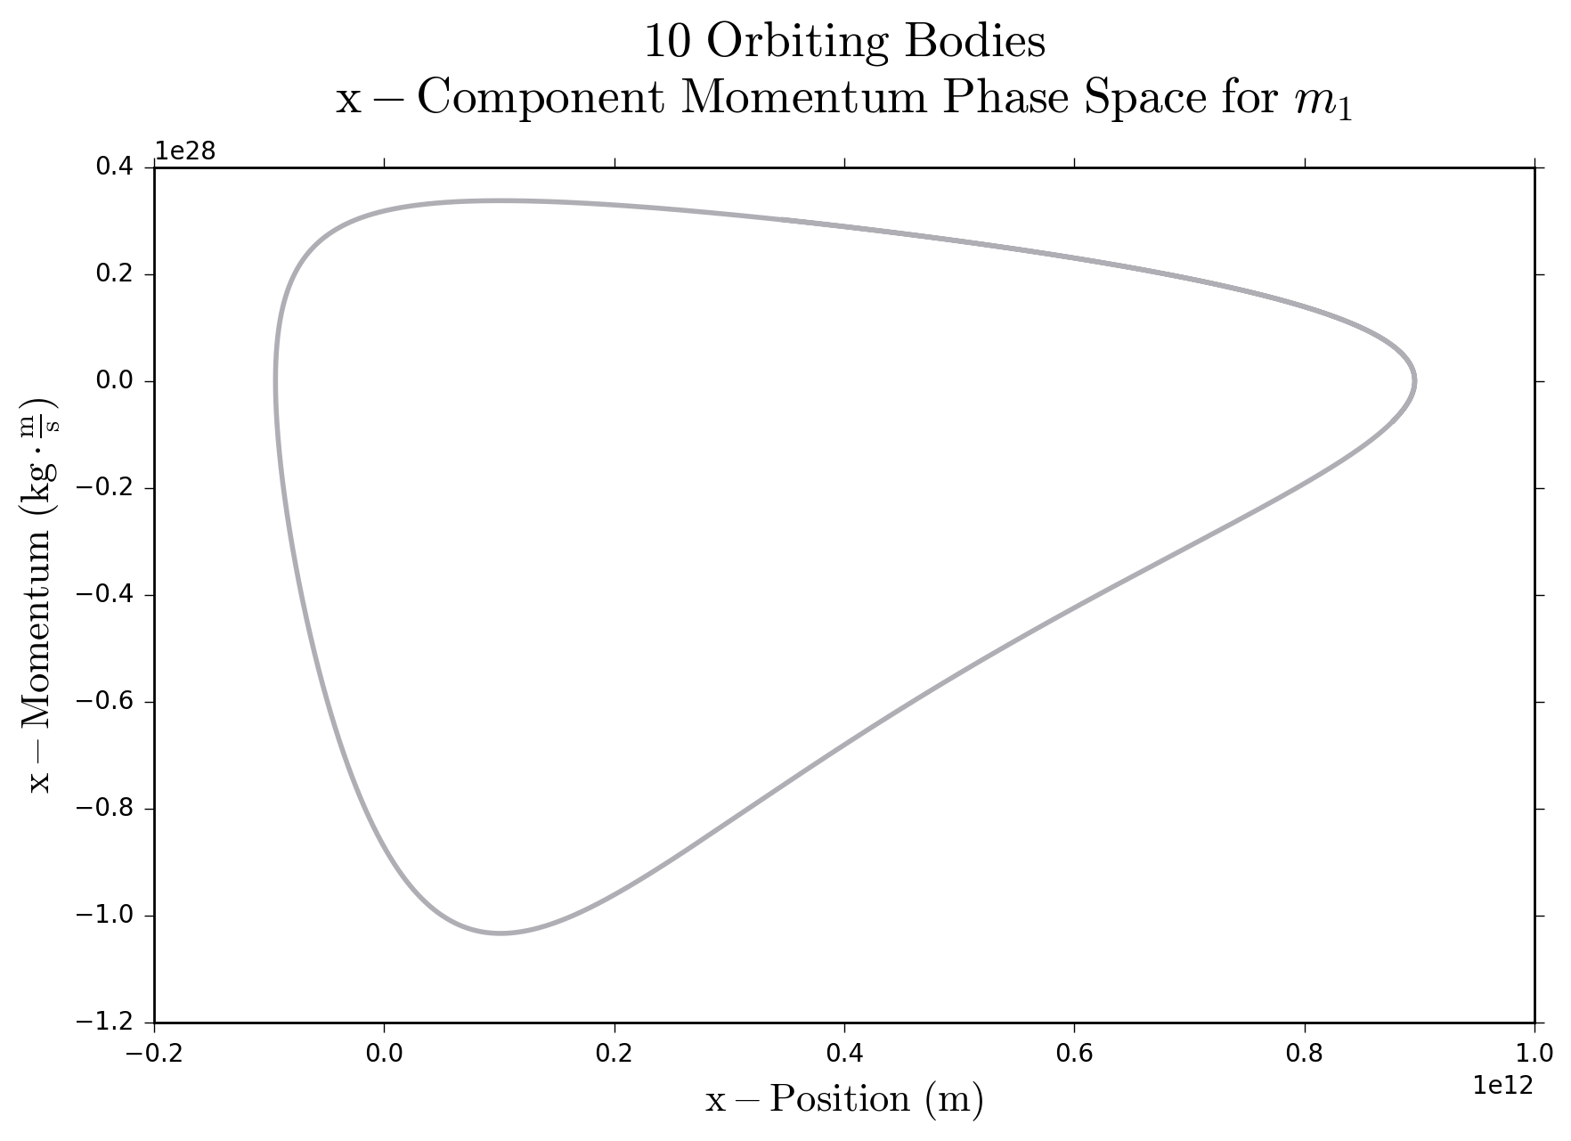
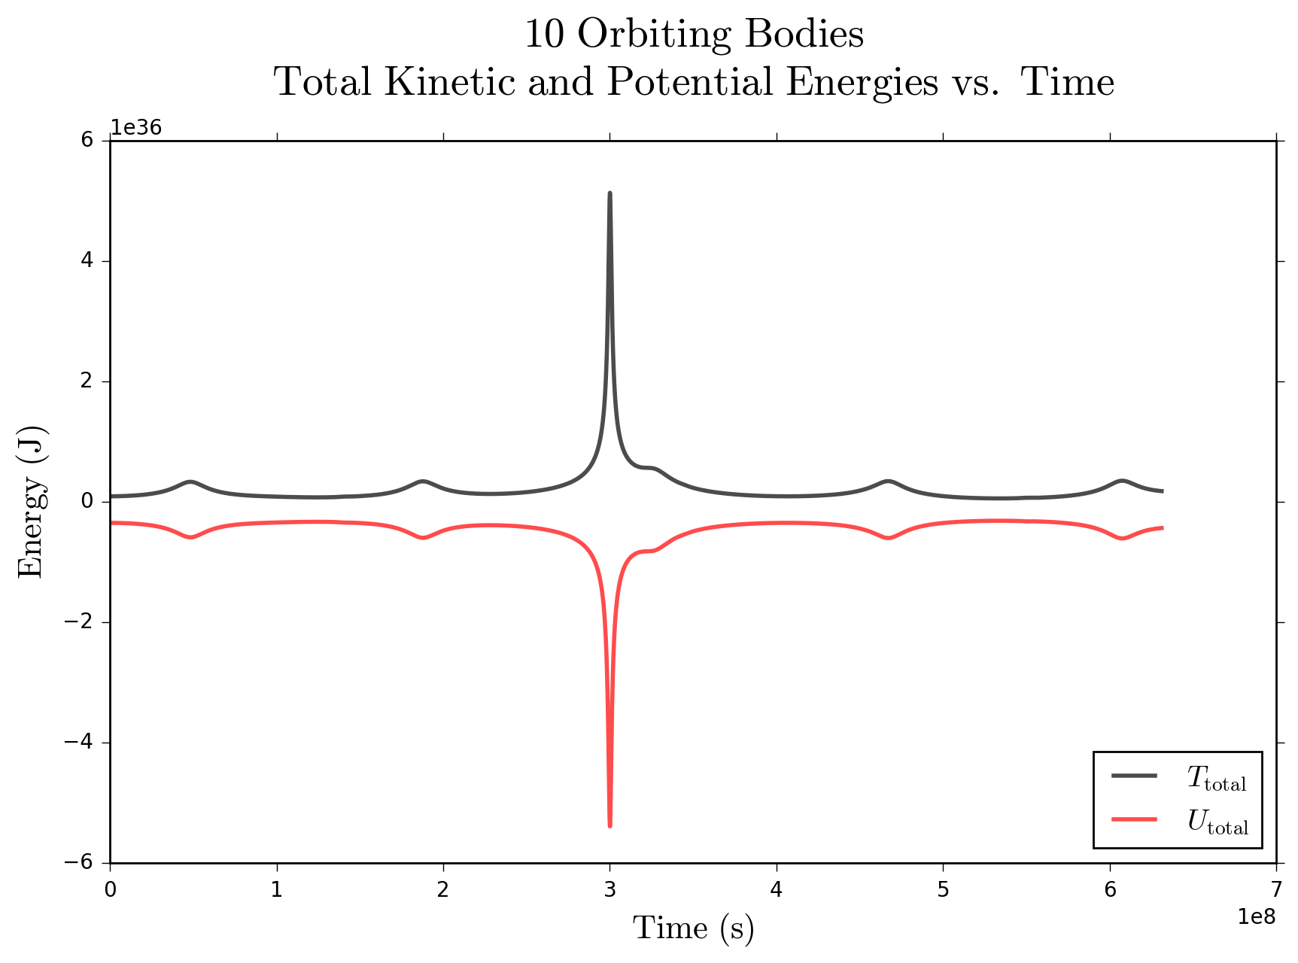
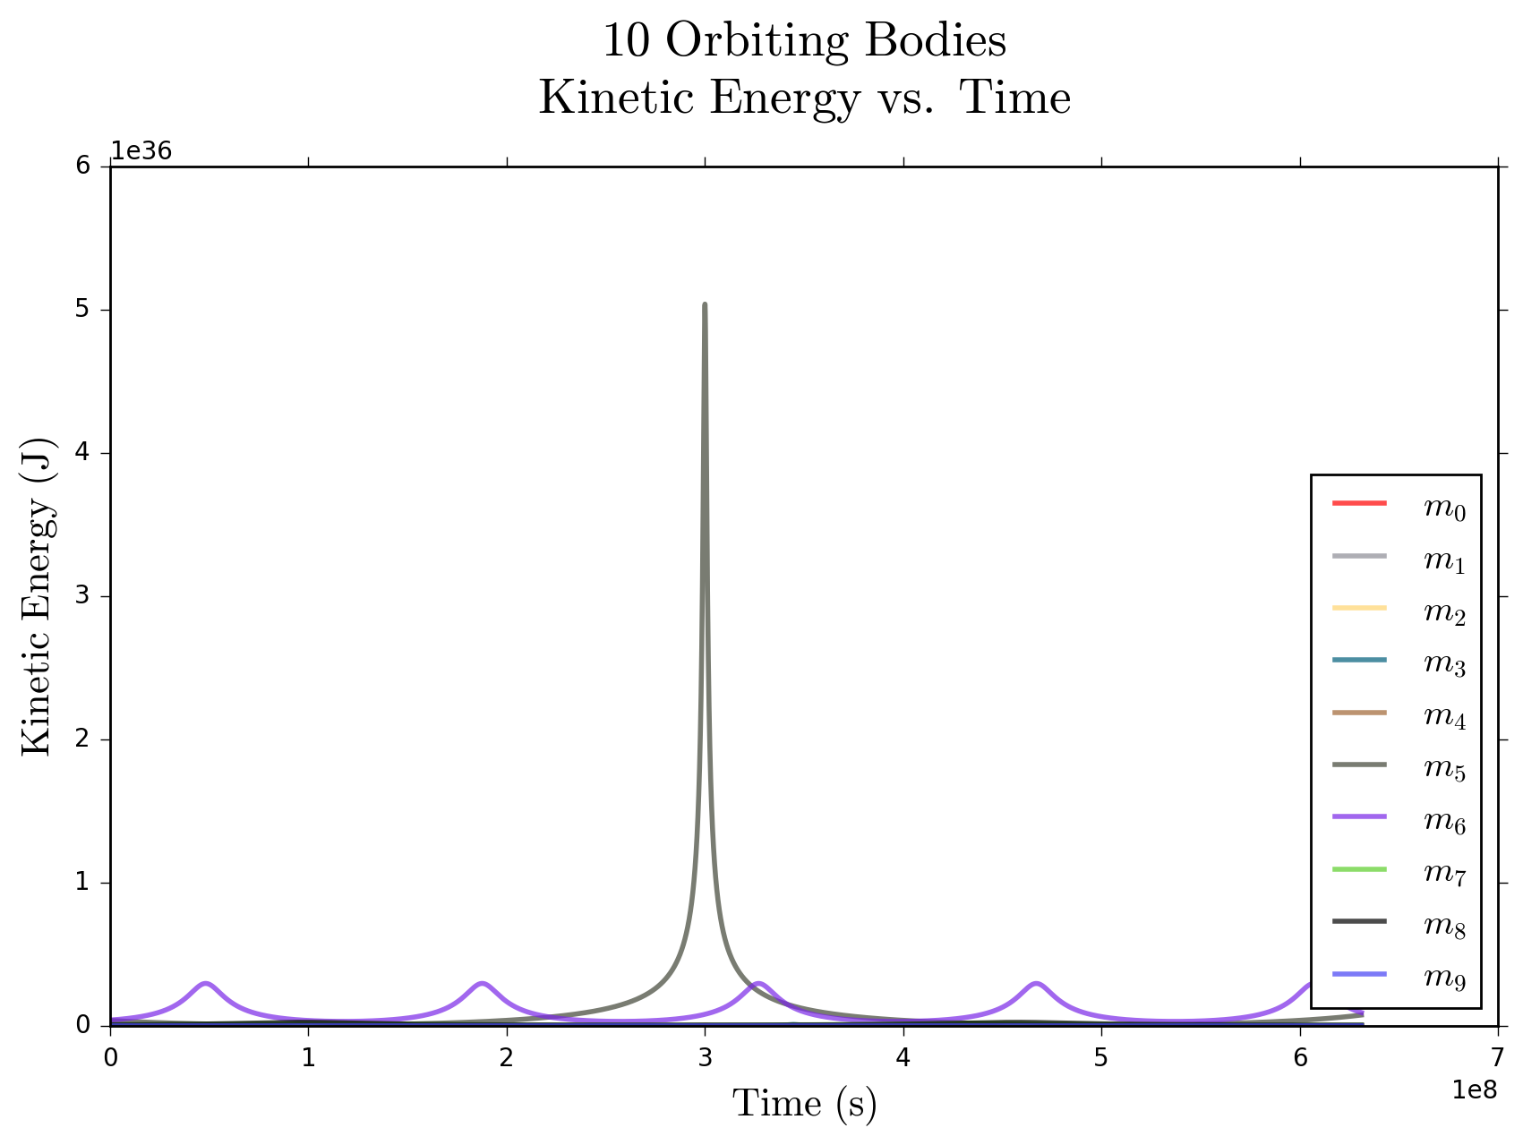
10 Bodies Similar to the Solar System

Slide 9
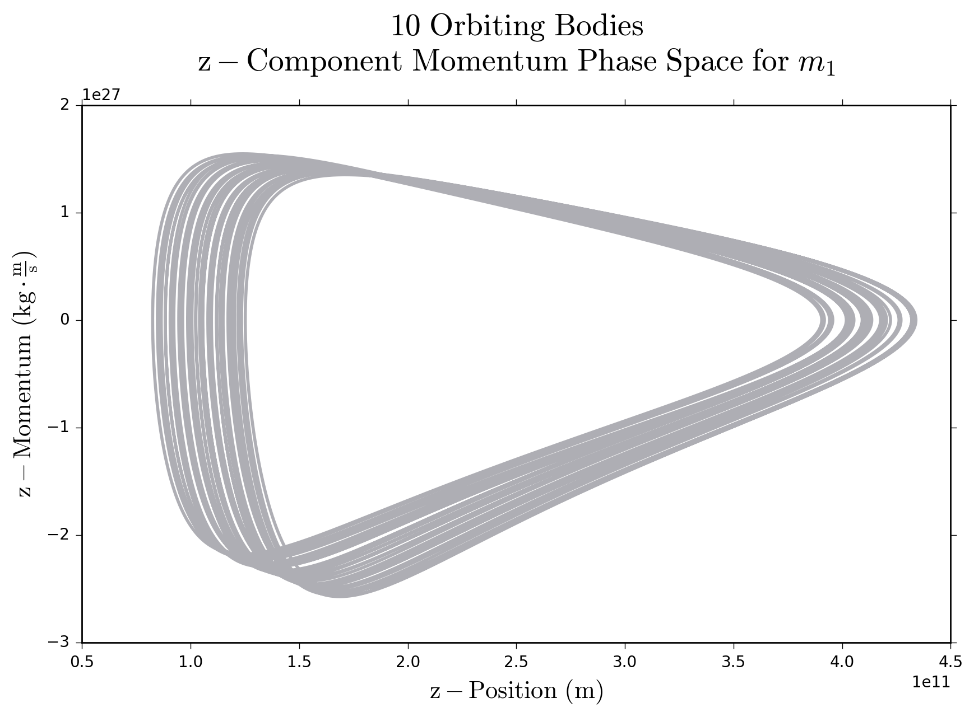
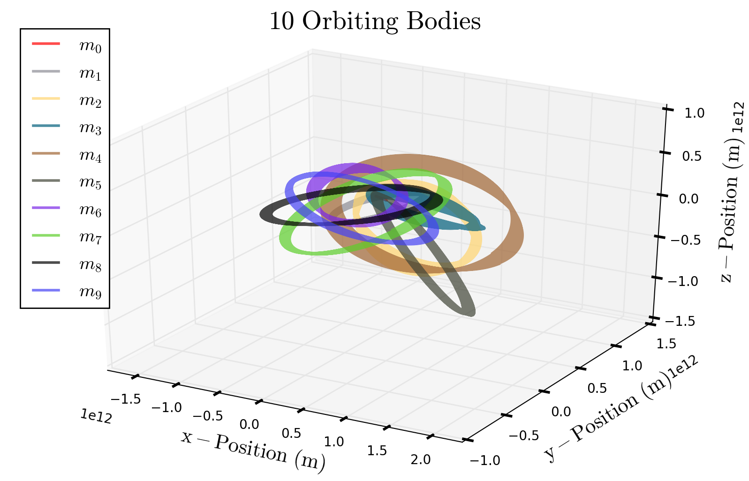
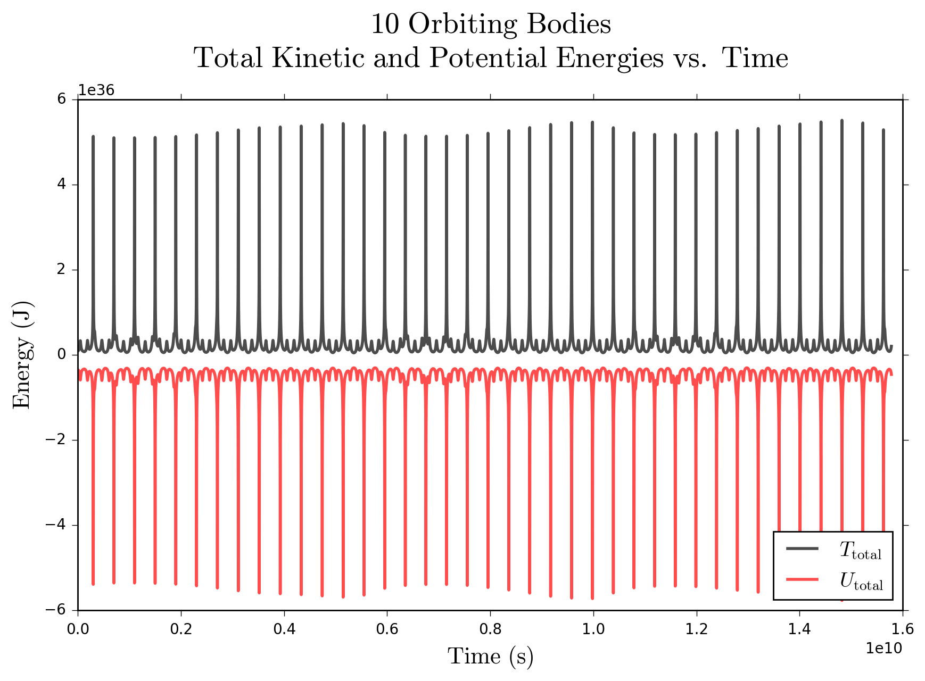
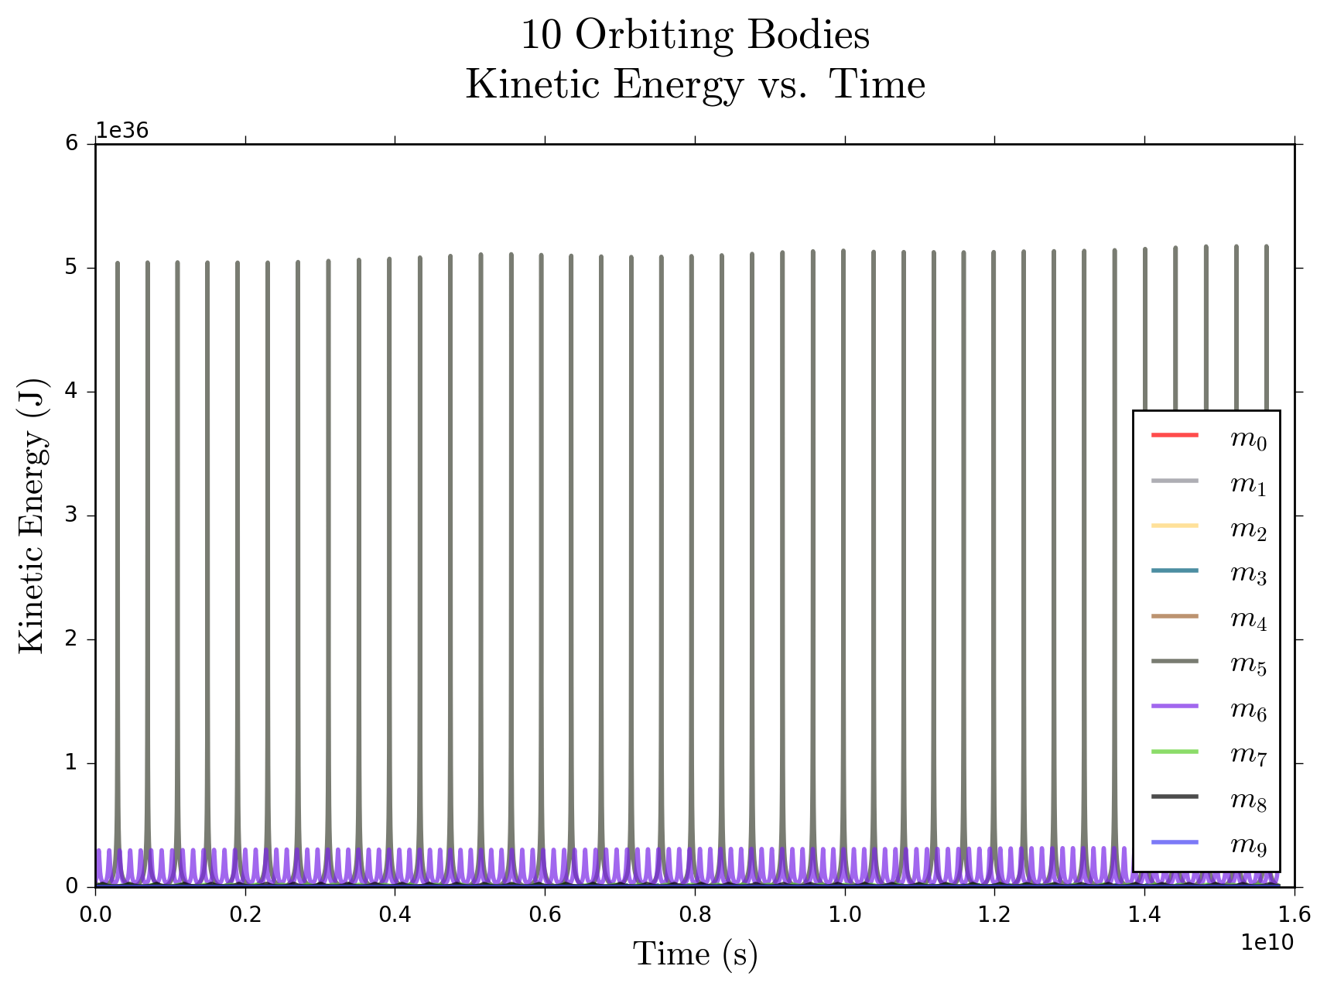
10 Bodies Extended for 500 Years

Slide 10
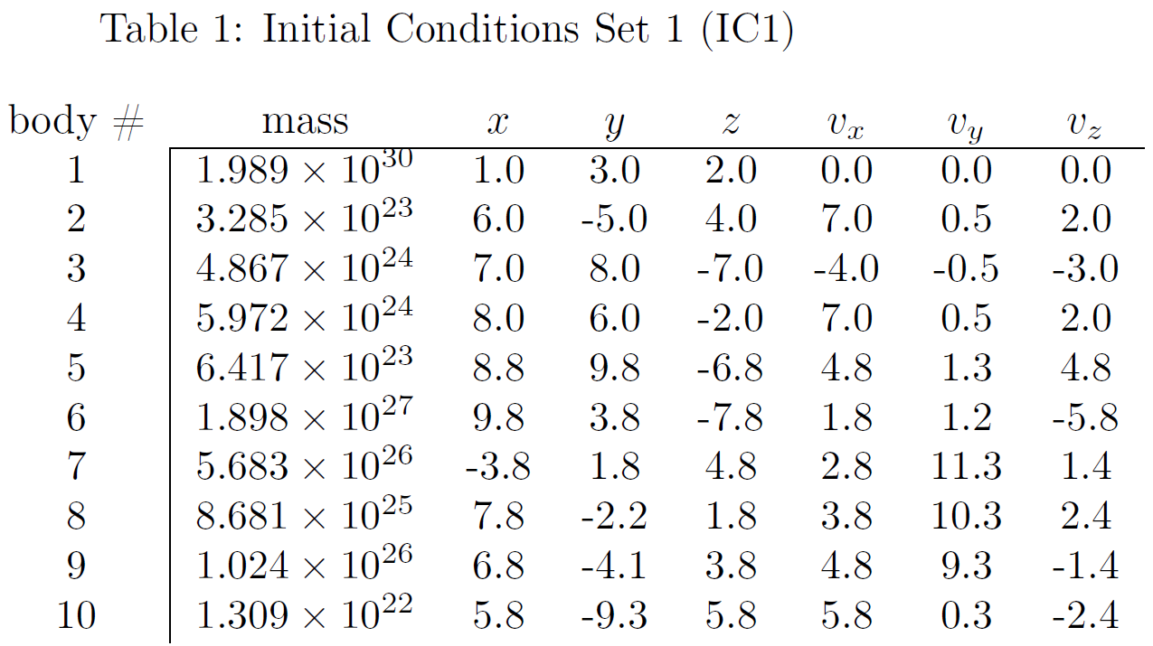
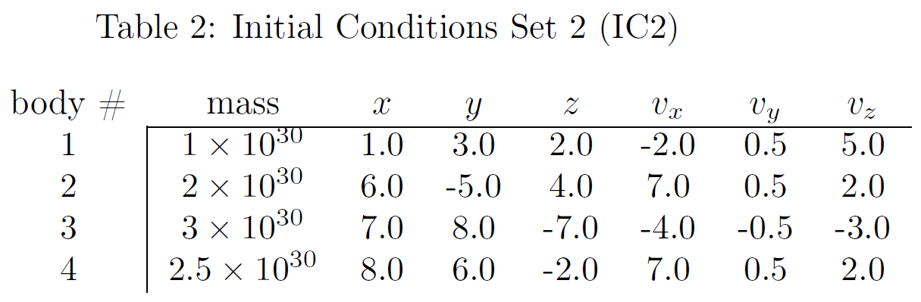
Thank You! Questions?
References:
General Mathematics
https://en.wikipedia.org/wiki/N-body_problem
PEFRL and VEFRL Algorithms
https://arxiv.org/pdf/cond-mat/0110585.pdf

